Slide 1
The Evolution of Knowledge on Climate Change: The Creativity and Innovation Challenge
By
Dr. R.K. Pachauri
Chief Mentor, POP Movement; and
Former Chairman, Intergovernmental Panel on Climate Change (IPCC), 2002-2015
Dubrovnik Roundtable on Mind, Thinking and Creativity
Dubrovnik
November 7, 2017

Slide 2
Schematic framework of anthropogenic climate change drivers, impacts and responses
IPCC AR4 SYR

Slide 3
The evolution of scientific knowledge on climate change
Svante Arrhenius
Subsequent work by other scientists including William Herschel, Hans Suess, Roger Revelle, Charles Keeling, James Hansen
1988 Congressional hearings
Establishment of IPCC in 1988

Slide 4
Social responsibility of stakeholders – Why?
Milton Friedman’s view
Kenneth Boulding & Spaceship Earth–Entropy
“Business cannot succeed in a society that fails.”
Negative & positive externalities
Tragedy of the commons - climate change
- biodiversity loss
bridging the gap between private vs. social

Slide 5
The IPCC Fifth Assessment Report
A clear and up to date view of the current state of scientific knowledge relevant to climate change.
Working group I
The Physical Science Basis
259 authors
39 countries
54,677 comments
2 million gigabytes of numerical data from climate model simulations
Over 9200 scientific publications cited
Working Group II
Impacts, Adaptation and Vulnerability
309 authors
70 countries
50,444 comments
Over 12,000 scientific references cited
Working Group III
Mitigation of Climate Change
235 authors
57 countries
38,315 comments
Close to 1200 scenarios of socioeconomic development analyzed
Close to 10,000 references to literature

Slide 6
The IPCC Synthesis Report
Integration of three Working Group Reports of the 5th Assessment, 2013-2014
WGI: The Physical Science Basis
WGII: Impacts, Adaptation and Vulnerability
WGIII: Climate Change Mitigation
51 members of the Core Writing Team
18 members of the Extended Writing Team
18 countries
8105 comments
Chaired by the IPCC Chair R.K. Pachauri
Member governments approved the SPM on 1 November 2014 (total membership of IPCC is 195 government)

Slide 7
Key Messages
Human influence on the climate system is clear
The more we disrupt our climate, the more we risk severe, pervasive and irreversible impacts
We have the means to limit climate change and build a more prosperous, sustainable future
AR5 WGI SPM, AR5 WGII SPM, AR5 WGIII SPM

Slide 8
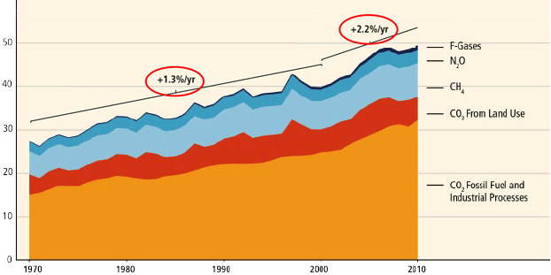
GHG emissions growth between 2000 and 2010 has been larger than in the previous three decades
GHG Emissions [GtCO2 eq/yr]
AR5 WGIII SPM

Slide 9
Sources of emissions
Energy production remains the primary driver of GHG emissions
24%
14%
6.4%
21%
35%
Building Sector
Agriculture, forests and other land uses
Industry
Transport
Energy Sector
2010 GHG emissions
AR5 WGIII SPM

Slide 10
Potential Impacts of Climate Change
Food and water shortages
Increased displacement of people
Increased poverty
Coastal flooding
AR5 WGII SPM

Slide 11
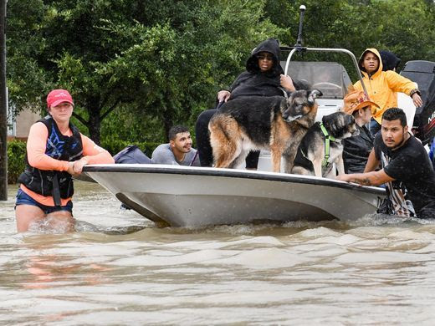
Hurricane Harvey, Texas 2017

Slide 12
An increase in extreme high sea levels
Source: Fortune, August 1, 2017

Slide 13
Ice deposit in a desert

Slide 14
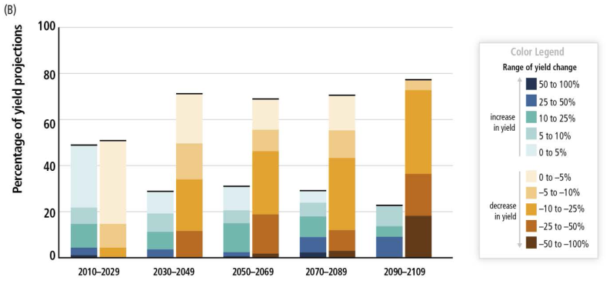
Climate Change Poses Risk for Food Production
Percentage of yield projections
AR5 SYR SPM

Slide 15
Limiting Temperature Increase to 2˚C
Global GHG emissions reduction of 40-70 % in 2050 compared to 2010
Net zero or negative GHG emissions in 2100
Global emissions to curb within next 5-15 years
Source: IPCC AR5 WGIII SPM

Slide 16
Mitigation Measures
More efficient use of energy
Greater use of low-carbon and no-carbon energy • Many of these technologies exist today
Improved carbon sinks • Reduced deforestation and improved forest management and planting of new forests • Bio-energy with carbon capture and storage
Lifestyle and behavioural changes
AR5 WGIII SPM

Slide 17
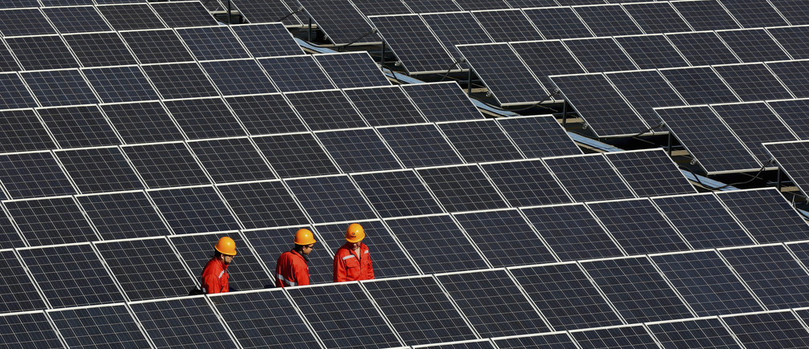
This region of China just ran on renewable energy for an entire week
Nationwide, China hopes to produce 20% of its electricity from clean sources by 2030. Image: REUTERS/Stringer
From Pittsburgh to Frankfurt, cities around the world are pledging to stop burning fossil fuels for electricity by 2050 or sooner.
But the Chinese province of Qinghai has already reached that goal, according to news outlet Xinhua. For seven days — from June 17 to 23 — the region ran on 100% renewable energy, including solar, wind, and hydropower.
Source: www.weforum.org

Slide 18
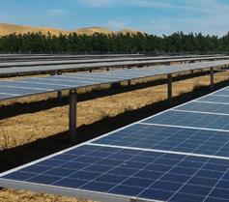
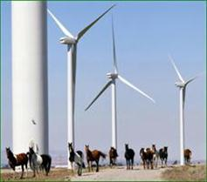
Carbon free Palo Alto
Palo Alto now has 100% carbon neutral electricity and natural gas! Since 2013, Palo Alto has provided 100% carbon neutral electricity and as of July 1, 2017 we will also provide 100% carbon neutral natural gas. Carbon neutral means no net emissions of greenhouse gases (GHGs) into the atmosphere. (Note: GHGs are emitted as part of the process of constructing energy generation facilities. When we refer to 100% carbon neutral, we are referring to the energy output from these generation facilities.)
Source: www.cityofpaloalto.org

Slide 19
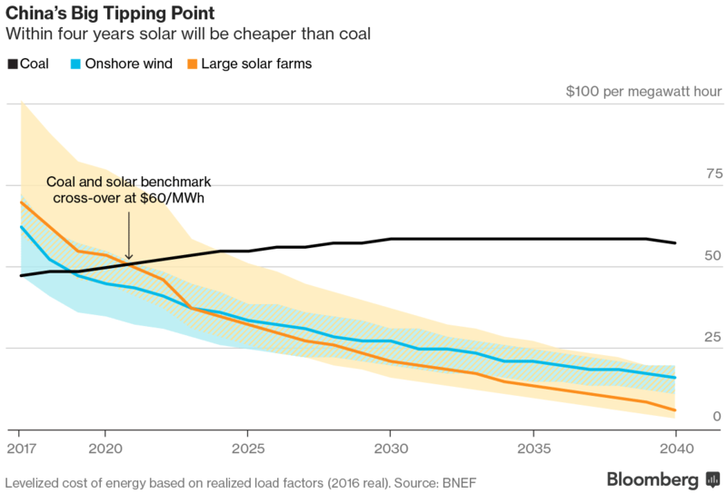
Levelized cost of energy based on realized load factors
Source: https://bloom.bg/2rl3pvQ

Slide 20
Renewables Freshen Dong Energy

Slide 21
Ambitious Mitigation Is Affordable
Economic growth reduced by ~ 0.06%
(BAU growth 1.6 - 3%)
This translates into delayed and not forgone growth
Estimated cost does not account for the benefits of reduced climate change
Unmitigated climate change would create increasing risks to economic growth
AR5 WGI SPM, AR5 WGII SPM

Slide 22
The Choices We Make Will Create Different Outcomes
With substantial mitigation
Without additional mitigation
Change in average surface temperature (1986–2005 to 2081–2100)
AR5 WGI SPM

Slide 23
Knowledge and innovation
Knowledge and climate change needs to drive innovation in
Policies including explicit consideration of externalities
Business practices
Consumer education
Lifestyle changes
Leadership by youth

Slide 24
“A technological society has two choices.
First it can wait until catastrophic
failures expose systemic deficiencies,
distortion and self deceptions…
Secondly, a culture can provide
social checks and balances to
correct for systemic distortion
prior to catastrophic failures”
- Mahatma Gandhi

